Slide 1

Chapter 6 Linked Lists

Slide 2

Outline
Links
A Simple Linked List
Finding and Deleting Specified Links
Double-Ended Lists（双端链表）
Linked-List Efficiency
Abstract Data Types
Sorted Lists
Doubly Linked Lists*（双向链表）
Iterators*（迭代器）

Slide 3
Disadvantages of arrays
Searching is slow
Insertion is slow
Unordered array
Ordered array
删除慢，数组的大小在创建后无法改变。

Slide 4
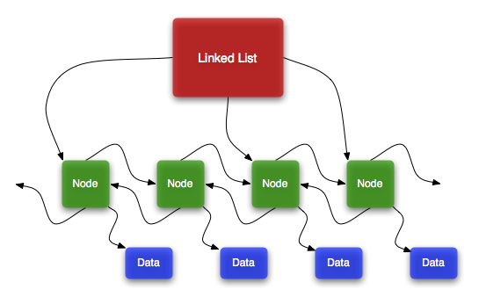
The linked list solves some of these problems.
Linked lists are the second most commonly used general purpose storage structures after arrays.
In fact, you can use a linked list in many cases in which you use an array, unless you need frequent random access to individual items using an index.

Slide 5
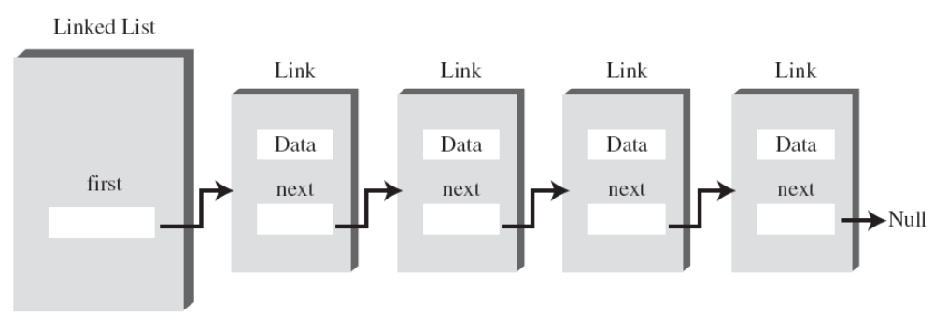
Links
In a linked list, each data item is embedded in (被嵌入于) a link.
Each Link object contains a reference (usually called next) to the next link in the list.
A field in the list itself contains a reference to the first link.

Slide 6
Links
Definition of a class Link（Link类的定义）
class Link
{
public int iData; // data
public double dData; // data
public Link next; // reference to next link
}
self-referential
How big a Link object is?
Link
Link
The answer is that in Java a Link object doesn’t really contain another Link object.
It s only a reference to another link, not an object.
Link
…

Slide 7
Links
References and Basic Types
It’s the object’s address in the computer’s memory, but you don’t need to know its value; you just treat it as a magic number that tells you where the object is.
All references are the same size.
Primitive types
A reference to an object
double salary = 65000.00;
Link aLink = someLink;
Creates a space in memory and puts the number 65000.00 into this space
Puts a reference to an object of type Link, called someLink, into aLink.

Slide 8
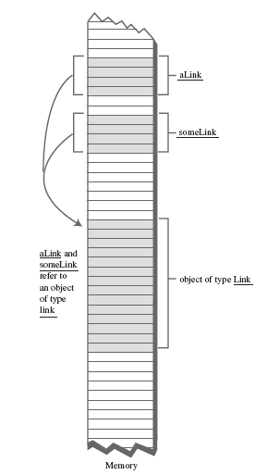
Objects and references in memory.
Link someLink = new Link();
Link aLink = someLink;
aLink
someLink
aLink and someLink
refer to an object
of type link
object of type Link

Slide 9
Links
Q：在链表中如何定位元素？
A：靠关系，而不是索引来定位。
In a list the only way to find a particular element is to follow along the chain of elements.
You can’t access a data item directly;
you must use relationships between the items to locate it.

Slide 10
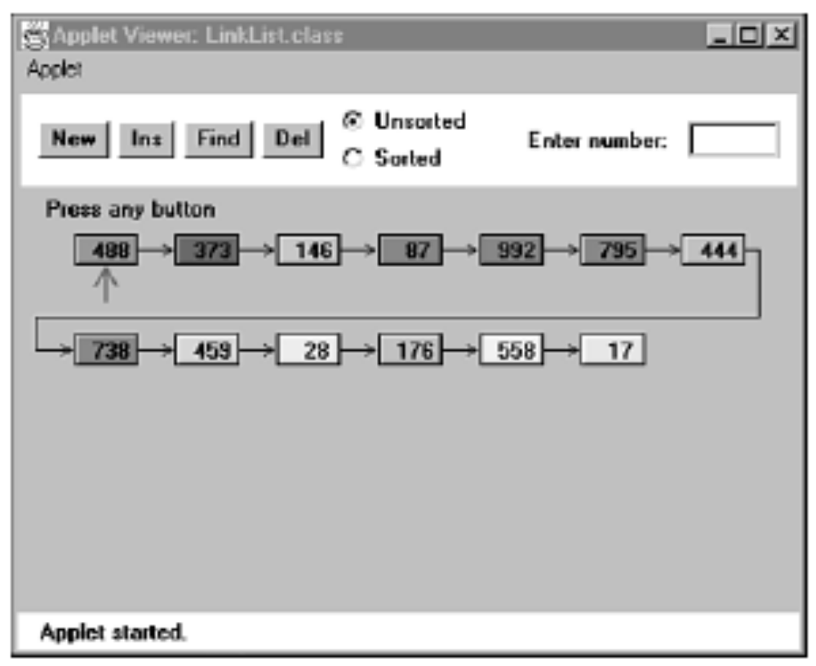
The LinkList Workshop Applet
The Insert Button
In this version of a linked list, new links are always inserted at the beginning of the list.
The Find Button
The Delete Button

Slide 11
A Simple Linked List
LinkList.java demonstrates a simple linked list.
The only operations allowed in this version of a list are：
• Inserting an item at the beginning of the list
• Deleting the item at the beginning of the list
• Iterating through the list to display its contents

Slide 12
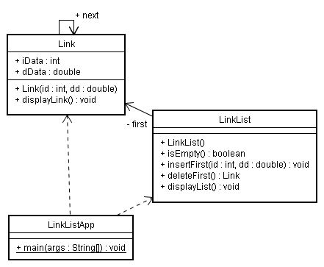
A Simple Linked List
The Link Class
The LinkList Class
The LinkListApp Class

Slide 13
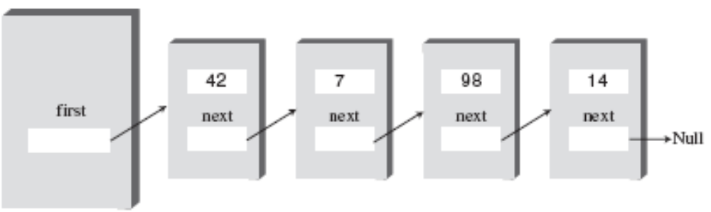
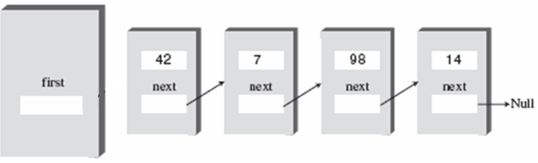

The insertFirst() Method
Link newLink = new Link(id, dd);
2
newLink.next = first; //1
first = newLink; //2
1

Slide 14
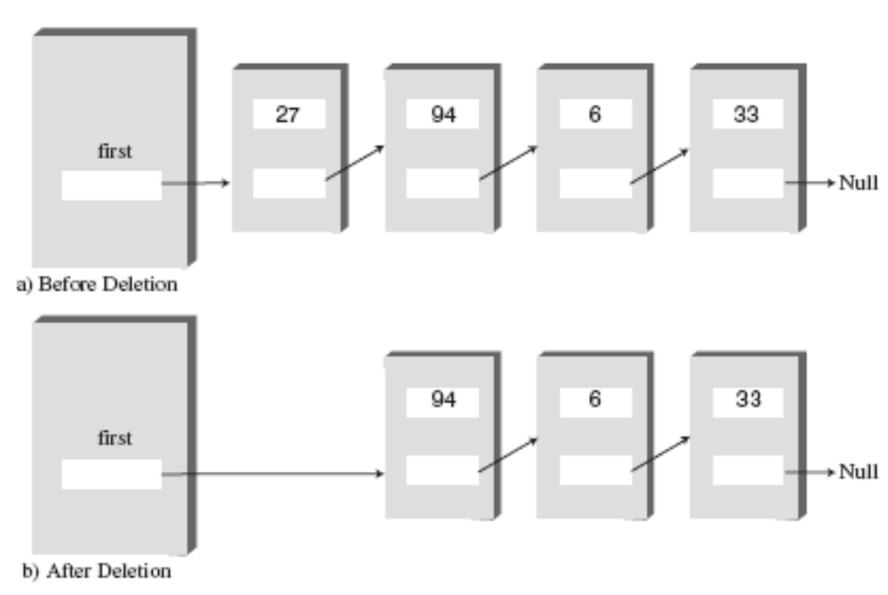
The deleteFirst() Method
public Link deleteFirst() // delete first item
{ // (assumes list not empty)
Link temp = first; // save reference to link
first = first.next; // delete it: first-->old next
return temp; // return deleted link
}

Slide 15
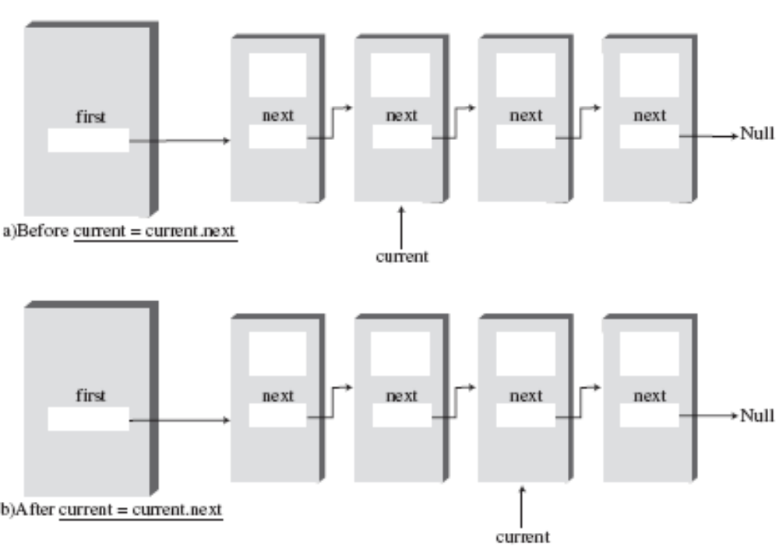
The displayList() Method
Before: current=current.next;
public void displayList(){
System.out.print(“List (first-->last): “);
Link current = first; // start at beginning of list
while(current != null){ // until end of list,
current.displayLink(); // print data
current = current.next; // move to next link
}
System.out.println(“”);
}
After: current=current.next;

Slide 16
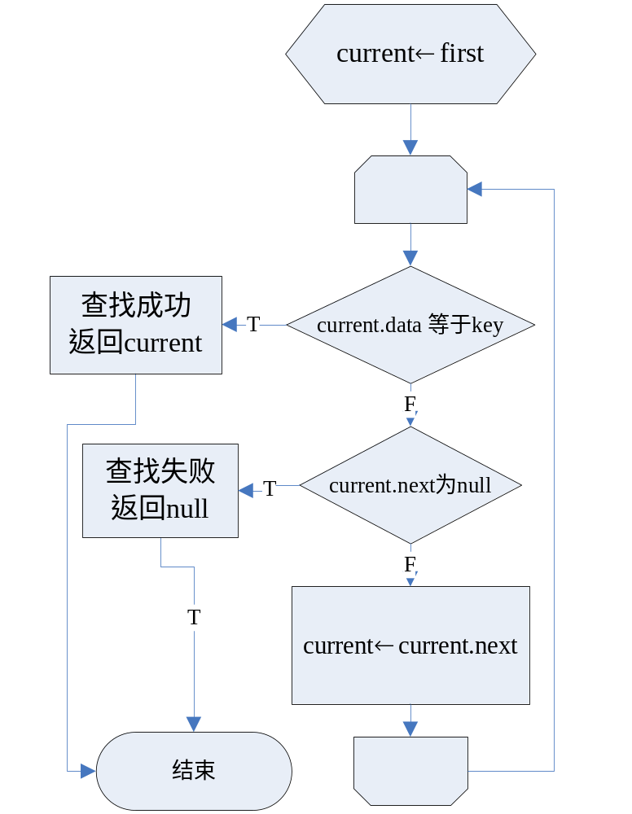
Search a linked list for a data item with a specified key value
The find() Method
current最初指向first，然后重复地更新为current.next,以此实现当前链结点的改变. 对于每个链结点，find方法检查当前的数据是否等于key。如果相等，就返回link。如果find()运行至表尾也未发现符合条件的link，返回null。
public Link find(int key) // find link with given key
{ // (assumes non-empty list)
Link current = first; // start at ‘first’
while(current.iData != key) // while no match,
{ if(current.next == null) // if end of list,
return null; // didn’t find it
else // not end of list,
current = current.next; // go to next link
}
return current; // found it
}

Slide 17
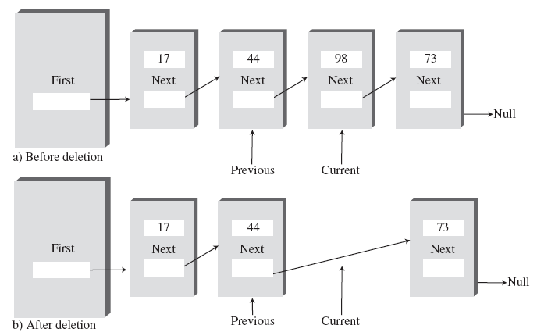
Deleting a specified link.
The delete() Method
Similar to find() --------It searches for the link to be deleted.
However, it needs to maintain a reference not only to the current link (Current), but to the link preceding the current link (Previous).
It does so because, if it deletes the current link, it must connect the preceding link to the following link. The only way to tell where the preceding link is located is to maintain a reference to it.
特殊情况？
If the current link is the first link because the first
link is pointed to by the LinkList’s first field and not by another link.
First link
Notes:
public Link delete(int key) // delete link with given key
{ // (assumes non-empty list)
Link current = first; // search for link
Link previous = first;
while(current.iData != key)
{
if(current.next == null)
return null; // didn't find it
else
{
previous = current; // go to next link
current = current.next;
}
} // found it
if(current == first) // if first link,
first = first.next; // change first
else // otherwise,
previous.next = current.next; // bypass it
return current;
}

Slide 18
Finding and Deleting Specified Links
Other Methods
We’ve seen methods to insert and delete items at the start of a list, and to find a specified item and delete a specified item.
What are the other useful list methods?
For example, an insertAfter() method could find a link with a specified key value and insert a new link following it. We’ll see such a method when we talk about list iterators（迭代器） at the end of this chapter.

Slide 19
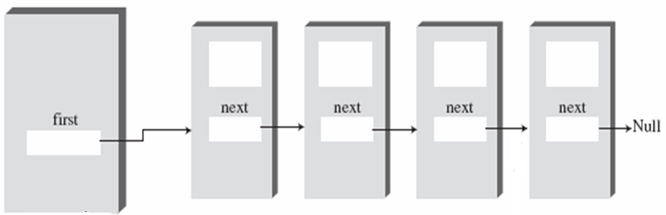
Double-Ended Lists
A double-ended list.(双端链表)
The reference to the last link permits you to insert a new link directly at the end of the list as well as at the beginning.
Queue
Double-ended list 能方便地访问表尾和表头，适合用于实现什么DS？
last

Slide 20
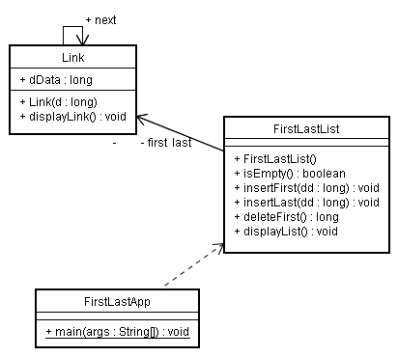
Finding and Deleting Specified Links
The firstLastList.java Program
A new method, insertLast(), that inserts a new item at the end of the list.

Slide 21
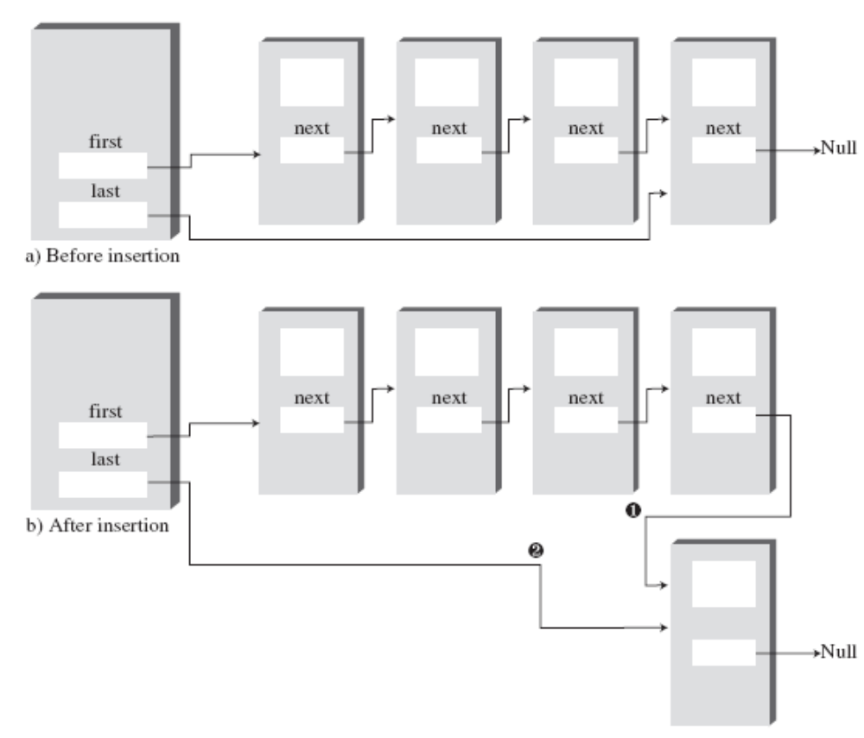
Insertion at the end of a list.
1
2
有几种情况？各需要改谁？
①和②能否交换次序？
Notes:
////////////////////////////////////////////////////////////////class FirstLastList { private Link first; // ref to first link private Link last; // ref to last link// ------------------------------------------------------------- public FirstLastList() // constructor { first = null; // no links on list yet last = null; }// ------------------------------------------------------------- public boolean isEmpty() // true if no links { return first==null; }// ------------------------------------------------------------- public void insertFirst(long dd) // insert at front of list { Link newLink = new Link(dd); // make new link if( isEmpty() ) // if empty list, last = newLink; // newLink <-- last newLink.next = first; // newLink --> old first first = newLink; // first --> newLink }
// -------------------------------------------------------------
public void insertLast(long dd) // insert at end of list {
Link newLink = new Link(dd); // make new link
if( isEmpty() ) // if empty list,
first = newLink; // first --> newLink
else
last.next = newLink;
// old last --> newLink
last = newLink;
// newLink <-- last
}
// ------------------------------------------------------------- public long deleteFirst() // delete first link { // (assumes non-empty list) long temp = first.dData; if(first.next == null) // if only one item last = null; // null <-- last first = first.next; // first --> old next return temp; }// ------------------------------------------------------------- public void displayList() { System.out.print("List (first-->last): "); Link current = first; // start at beginning while(current != null) // until end of list, { current.displayLink(); // print data current = current.next; // move to next link } System.out.println(""); }// ------------------------------------------------------------- } // end class FirstLastList////////////////////////////////////////////////////////////////

Slide 22

Linked-List Efficiency
Insertion and deletion at the beginning of a linked list are very fast.
They involve changing only one or two references, which takes O(1) time.
Finding, deleting, or inserting requires searching through, on the average, half the items in the list. This requires O(N) comparisons.
Linked list
Array
-Linked list is faster than array because nothing needs to be moved when an item is inserted or deleted.
-Another important advantage of linked lists over arrays is that a linked list uses exactly as much memory as it needs and can expand to fill all of available memory.

Slide 23
Abstract Data Types
What is an ADT?
It’s a way of looking at a data structure: focusing on what it does（做什么） and ignoring how it does（怎么做） its job.
Examples of ADTs---Stacks & Queues
They can be considered separately from their implementation.
They have “abstract” nature.

Slide 24

Abstract Data Types
A Stack Implemented by a Linked List
Array version
Linked-list version
Push()
arr[++top] = data;
theList.insertFirst(data)
Pop()
data = arr[top--];
data = theList.deleteFirst()
The user of the stack class calls push() and pop() to insert and delete items without knowing, or needing to know, whether the stack is implemented as an array or as a linked list.
What’s the benefit?

Slide 25
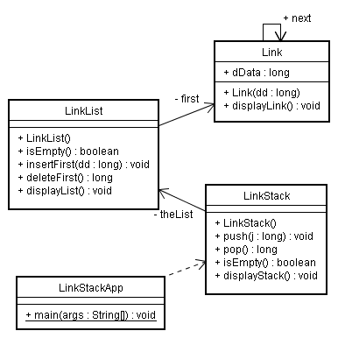
Abstract Data Types
Notice the overall organization of this program. The main() routine in the LinkStackApp class relates only to the LinkStack class. The LinkStack class relates only to the LinkList class. There’s no communication between main() and the LinkList class.
LinkStack.java
对于调用者（例如main函数）而言，无论是使用基于链表的栈或是基于数组的栈，都可以用同样的代码（除了构造栈的方法）。

Slide 26
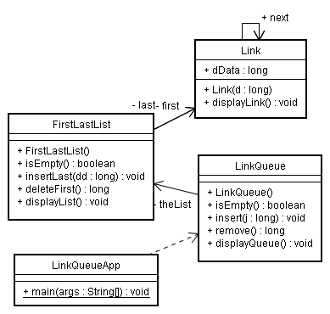
Abstract Data Types
A Queue Implemented by a Linked List
Here the methods insert() and remove() in the LinkQueue class are implemented by the insertLast() and deleteFirst() methods of the FirstLastList class. We’ve substituted
a linked list for the array used to implement the queue.

Slide 27
Abstract Data Types
Data Types and Abstraction
Data Types
Primitive type：由两方面构成，一是数据类型本身的特性（所占的存储空间，允许存储的数据）、二是对数据所能进行的操作.
自定义的class type：两方面构成，一是 data (fields) 、二是对fields所允许的操作（permissible operations on that data).
Abstraction
In object-oriented programming, then, an Abstract Data Type is a class considered without regard to its implementation.
As a class user, you’re told what methods to call, how to call them, and the results you can expect, but not how they work.
The Interface
An ADT specification is often called an interface. It’s what the class user sees—usually its public methods. In a stack class, push() and pop() and similar methods form the interface.

Slide 28
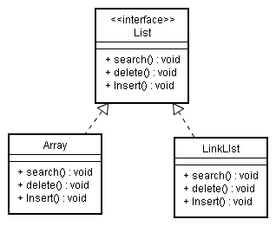
Abstract Data Types
ADT Lists
List----They’re lined up in a certain way, like beads on a string or houses on a street. Lists support certain fundamental operations.
It is defined by its interface and is an abstraction of Array or Linked list.
ADTs as a Design Tool
在软件设计过程中，如果需要存储数据，你首先需要考虑：
（1）对这些数据需要做那些操作？
（2）是否需要对某个特定位置（最前、最后或者某个元素之后）进行插入操作？
这些问题可以由选择适当的ADTs来解决。当ADTs确定后，你才需要考虑访问数据的代码。

Slide 29
Abstract Data Types
ADTs as a Design Tool
把 ADT从实现细节中解耦之后，可以简化设计过程--你可以在将来更容易地更改代码。如果客户只是和 ADT接口打交道,你将能够更改接口的实现代码（例如把LinkStack中的LinkList换为Array），而不再需要更改客户代码（例如main函数）.
当然，当ADT设计好以后，内部的数据结构也要精心挑选，以保证尽可能有效率地完成其特定的操作。
E.g. If you need random access to element N, for example, the linked-list representation isn’t so good because random access isn’t an efficient operation for a linked list. You’d be better off with an array.

Slide 30
Sorted Lists
For certain applications it’s useful to maintain the data in sorted order within the list. A list with this characteristic is called a sorted list.
Advantages over a sorted array:
Speed of insertion (because elements don’t need to be moved)
Can expand to fill available memory, while an array is limited to a fixed size.
However, a sorted list is somewhat more difficult to implement than a sorted array.

Slide 31
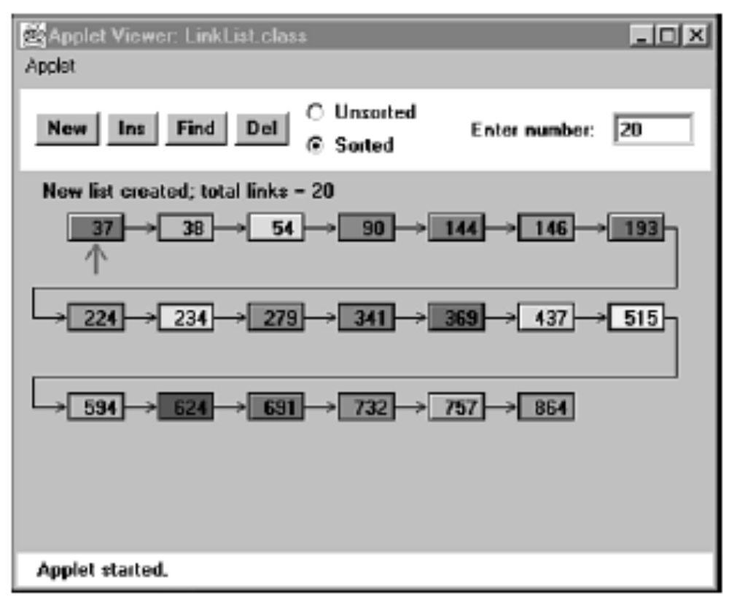
Sorted Lists
The LinkList Workshop applet

Slide 32
Java Code to Insert an Item in a Sorted List
public void insert(long key) // insert in order
{
Link newLink = new Link(key); // make new link
Link previous = null; // start at first
Link current = first;
// until end of list,
while(current != null && key > current.dData)
{ // or key > current,
previous = current;
current = current.next; // go to next item
}
if(previous==null) // at beginning of list
first = newLink; // first --> newLink
else // not at beginning
previous.next = newLink; // old prev --> newLink
newLink.next = current; // newLink --> old current
} // end insert()
Q:
To insert an item in a sorted list, what is the first step?
A:
Finds the appropriate place to put the item.
Q:
How to find the appropriate place?
A:
It is just before the first item that’s larger.

Slide 33
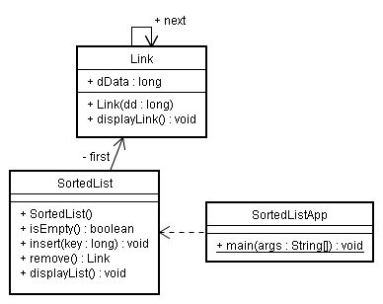
Sorted Lists
The sortedList.java Program

Slide 34
Sorted Lists
Efficiency of Sorted Linked Lists
Insertion and deletion of arbitrary(特定的) items in the sorted linked list require O(N) comparisons (N/2 on the average) because the appropriate location must be found by stepping through the list.
However, the minimum value can be found, or deleted, in O(1) time because it’s at the beginning of the list.
A priority queue might be implemented by a sorted linked list, for example.

Slide 35
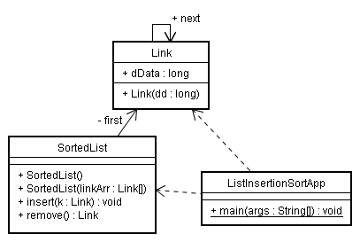
Sorted Lists
List Insertion Sort
A new constructor for SortedList takes an array of Link objects as an argument and inserts the entire contents of this array into the newly created list. By doing so, it helps make things easier for the client (the main() routine).
A change to the insert() routine in this program. It now accepts a Link object as an argument, rather than a long.
More than twice as much memory

Slide 36
Doubly Linked Lists（双向链表）
What’s the advantage of a doubly linked list?
A ordinary linked has difficult to traverse backward along the list.
A statement like
current=current.next
steps conveniently to the next link, but there’s no corresponding way(相应的方式) to go to the previous link.
The doubly linked list allows you to traverse backward as well as forward through the list.

Slide 37
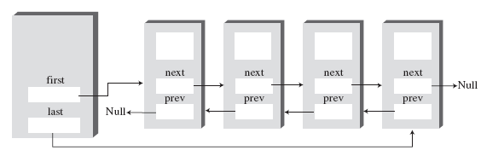
Doubly Linked Lists
class Link
{
public long dData; // data item
public Link next; // next link in list
public link previous; //previous linkin list
...
}
A doubly linked list.

Slide 38
Doubly Linked Lists
The downside（缺点） of doubly linked
Every time you insert or delete a link you must deal with four links instead of two: two attachments to the previous link and two attachments to the following one.
Each link is a little bigger because of the extra reference.
Traversal（遍历）
Link current = last; // start at end
while(current != null) // until start of list,
current = current.previous; // move to previous link

Slide 39
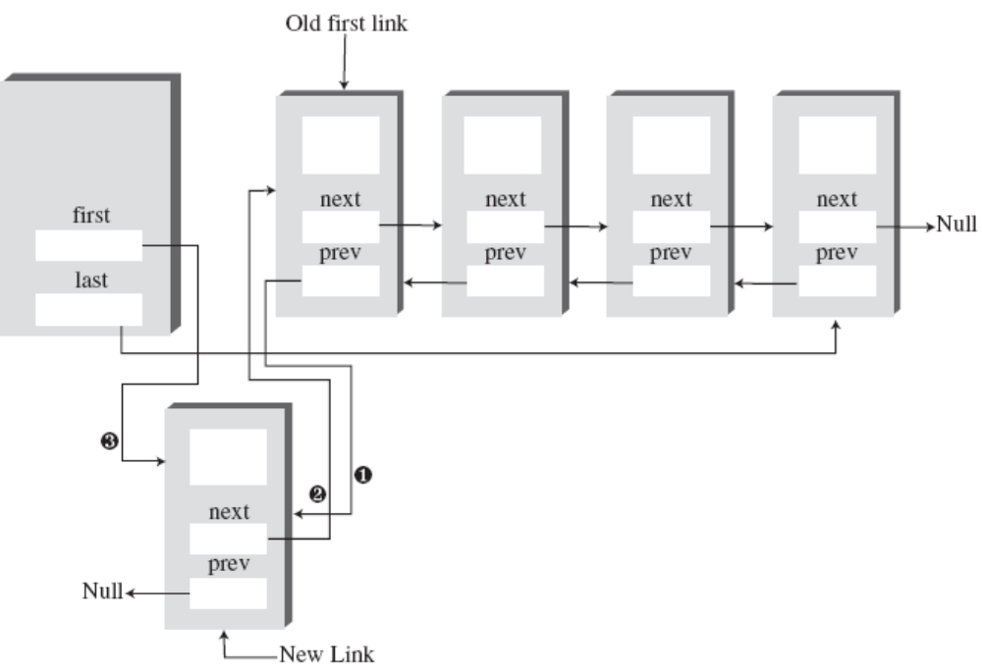
Insertion at the beginning
要改
要改？
要改?
3
if( isEmpty() ) // if empty list,
last = newLink; // newLink <-- last
else
first.previous = newLink; // newLink <-- old first
newLink.next = first; // newLink --> old first
first = newLink; // first --> newLink
1
2
要改

Slide 40
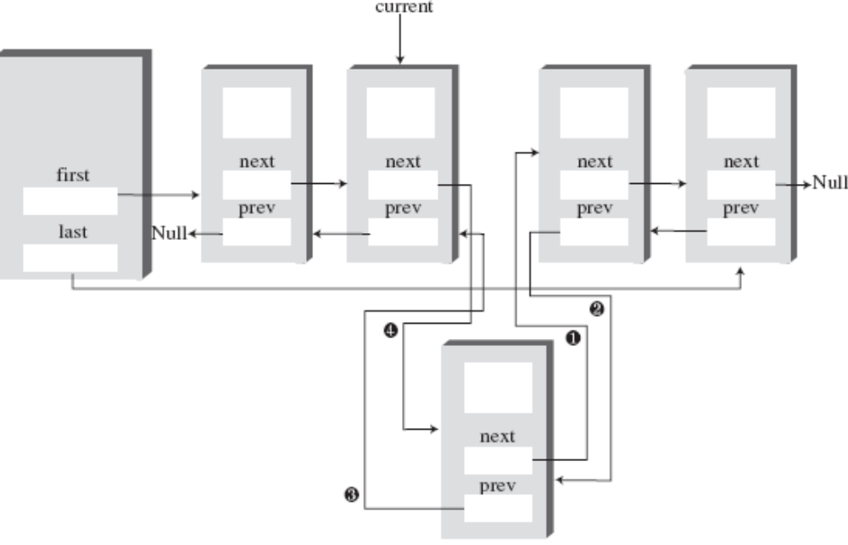
Insertion at an arbitrary location（指定位置）
要改
要改？
要改？
要改？
要改

Slide 41
思考题
在多线程环境下，如果有多于1个客户对象同时调用同一个DoublyList对象的同一个方法，会发生什么问题？
c1:ClientApp
insertAfter(150)
List:DoublyList
first=100
insertAfter(150)
c2:ClientApp
会发生同步问题，需要在需要保护的代码加锁，一次只能一个线程用，具体做法是在方法声明加上synchronized关键字。

Slide 42
The insertAfter() code
if(current==last) // if last link,
{
newLink.next = null; // newLink ← null
last = newLink; // newLink → last
}
else // not last link,
{
newLink.next = current.next; // newLink→ old next
// newLink ←old next
current.next.previous = newLink;
}
newLink.previous = current; // old current ← newLink
current.next = newLink; // old current → newLink

Slide 43
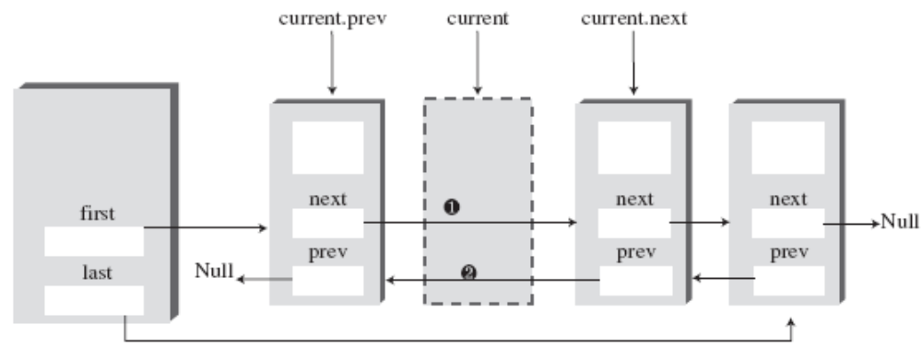
Doubly Linked Lists
Deletion
deleteFirst(), deleteLast(), and deleteKey().
Deleting an arbitrary link.

Slide 44

Doubly Linked Lists
Code from deleteKey() for dealing with link connections:
if(current==first) // first item?
first = current.next; // first --> old next
else // not first
// old previous --> old next
current.previous.next = current.next;
if(current==last) // last item?
last = current.previous; // old previous <-- last
else // not last
// old previous <-- old next
current.next.previous = current.previous;

Slide 45
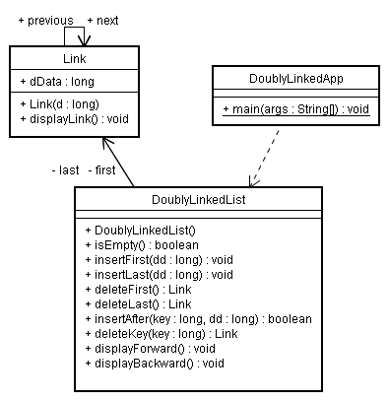
The doublyLinked.java Program

Slide 46
Doubly Linked Lists
用双向链表实现双端队列（deque）
A doubly linked list can be used as the basis for a deque, mentioned in the preceding chapter.
In a deque you can insert and delete at either end, and the doubly linked list provides this capability.

Slide 47
Iterators（迭代器）
Suppose you wanted to traverse a list, performing some operation on certain links.(假设你想遍历一个list，对某些节点做某种操作)
In an array, such operations are easy because you can use an array index to keep track of your position.
However, in a linked list, the links don’t have fixed index numbers. How can we provide a list’s user with something analogous（类似） to an array index?
Requires many comparisons to find each link.
Repeatedly use find()？
It’s far more efficient to step from link to link, checking whether each one meets certain criteria and performing the appropriate operation if it does.

Slide 48
Iterators
A Reference in the List Itself?
Assuming we create such a reference, where will it be installed?
Problem：you might need more than one such reference,
just as you often use several array indices at the same time.
To make this possible in an object-oriented language, it’s natural to embed each reference in a class object.
class LinkList
{
...
}
class LinkIterator
{
...
}
分离出
private Link current;

Slide 49
Iterators
To use such an iterator, the user might create a list and then create an iterator object associated with the list.
public static void main(...)
{
LinkList theList = new LinkList(); // make list
ListIterator iter1 = theList.getIterator(); // make iter
Link aLink = iter1.getCurrent(); // access link at iterator
iter1.nextLink(); // move iter to next link
}
After we’ve made the iterator object, we can use it to access the link it points to or increment it so it points to the next link.

Slide 50
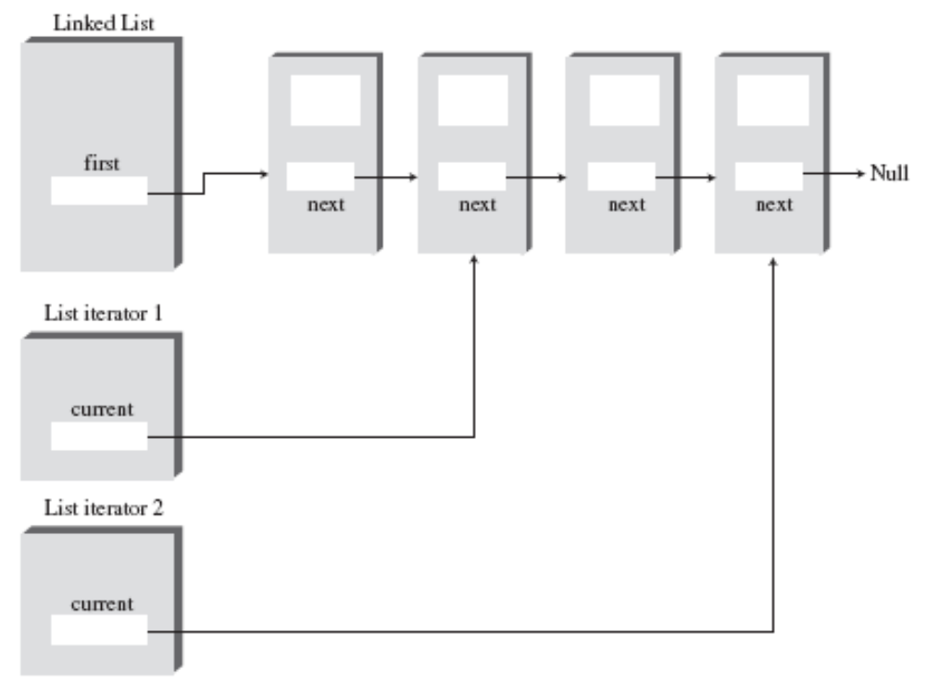
Iterators
Two iterators pointing to links in a list.

Slide 51
Additional Iterator Features
class ListIterator()
{
private Link current; //reference to current link
private Link previous; // reference to previous link
private LinkList ourList; // reference to “parent” list
public void reset() // set to start of list
{
current = ourList.getFirst(); // current --> first
previous = null; // previous --> null
}
public void nextLink() // go to next link
{
previous = current; // set previous to this
current = current.next; // set this to next
}
...
}
If the iterator is an object of a separate class, how can it access a private field, such as first, in the list?
Here’s a revised (although still incomplete) iterator class that incorporates these additional fields, along with reset() and nextLink() methods

Slide 52
Iterators
Iterator Methods
• reset()—Sets the iterator to the start of the list
• nextLink()—Moves the iterator to the next link
• getCurrent()—Returns the link at the iterator
• atEnd()—Returns true if the iterator is at the end of the list
• insertAfter()—Inserts a new link after the iterator
• insertBefore()—Inserts a new link before the iterator
• deleteCurrent()—Deletes the link at the iterator
The user can position the iterator using reset() and nextLink(), check whether it’s at the end of the list with atEnd(), and perform the other operations shown.

Slide 53
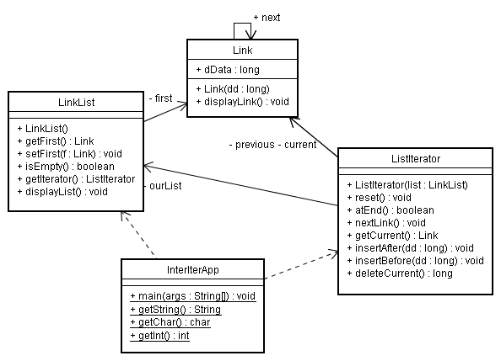
Iterators
The interIterator.java Program

Slide 54
Iterators
Where Does the Iterator Point?
deleteCurrent() :move the iterator to the link following the deleted link.
Following calls to insertBefore() and insertAfter(), we return with current pointing to the newly inserted item.
Iterative Operations
iter1.reset(); // start at first
long value = iter1.getCurrent().dData; // display link
System.out.println(value + “ “);
while( !iter1.atEnd() ) // until end,
{
iter1.nextLink(); // go to next link,
long value = iter1.getCurrent().dData; // display it
System.out.println(value + “ “);
}

Slide 55
class InterIterApp
{
public static void main(String[] args) throws IOException
{
LinkList theList = new LinkList(); // new list
ListIterator iter1 = theList.getIterator(); // new iter
iter1.insertAfter(21); // insert links
iter1.insertAfter(40);
iter1.insertAfter(30);
iter1.insertAfter(7);
iter1.insertAfter(45);
theList.displayList(); // display list
iter1.reset(); // start at first link
Link aLink = iter1.getCurrent(); // get it
if(aLink.dData % 3 == 0) // if divisible by 3,
iter1.deleteCurrent(); // delete it
while( !iter1.atEnd() ) // until end of list,
{
iter1.nextLink(); // go to next link
aLink = iter1.getCurrent(); // get link
if(aLink.dData % 3 == 0) // if divisible by 3,
iter1.deleteCurrent(); // delete it
}
theList.displayList(); // display list
} // end main()
} // end class InterIterApp
The following code shows how you could delete all items with keys that are multiples of 3.
代码：
如何删除链表中能被3整除的节点

Slide 56
Other Methods
You could create other useful methods for the ListIterator class. For example, a find() method would return an item with a specified key value, as we’ve seen when find() is a list method. A replace() method could replace items that had certain key values with other items.

Slide 57
Summary
链表包含一个LinkedList对象和许多Link对象
linkedList对象包含一个引用，这个引用通常叫做first，它指向链表的第一个链结点。
每个Link对象包含数据和一个引用，通常叫做next，它指向链表的下一个链结点。
next字段为nu11值意味着链表的结尾。
在表头插入链结点需要把新链结点的next字段指向原来的第一个链结点，然后把first指向新链结点。
在表头删除链结点要把first指向first.next o
为了遍历链表，从first开始，然后从一个链结点到下一个链结点，方法是用每个链结点的next字段找到下一个链结点。

Slide 58

通过遍历链表可以找到拥有特定值的链结点。一旦找到，可以显示、删除或用其他方式操纵该链结点。
新链结点可以插在某个特定值的链结点的前面或后面，首先要遍历找到这个链结点。
双端链表在链表中维护一个指向最后一个链结点的引用，它通常和first一样，叫做Iasto双端链表允许在表尾插入数据项。
抽象数据类型是一种数据存储类，不涉及它的实现。
栈和队列是ADT。它们既可以用数组实现，又可以用链表实现。
有序链表中，链结点按照关键值升序(有时是降序)排列。

Slide 59
在有序链表中插入需要O(N)的时间，因为必须找到正确的插入点。最小值链结点的删除需要O(1)的时间。
双向链表中，每个链结点包含对前一个链结点的引用，同时有对后一个链结点的引用。
双向链表允许反向遍历，并可以从表尾删除。
迭代器是一个引用，它被封装在类对象中，这个引用指向相关联的链表中的链结点。
迭代器方法允许使用者沿链表移动迭代器，并访问当前指示的链结点。
能用迭代器遍历链表，在选定的链结点(或所有链结点)上执行某些操作。

Slide 60
Assignment
Experiments
1. Use the LinkList Workshop applet to execute insert, find, and delete operations
on both sorted and unsorted lists. For the operations demonstrated by this applet, is there any advantage to the sorted list?
2. Modify main() in the linkList.java program (Listing 5.1) so that it continuously
inserts links into the list until memory is exhausted. After each 1,000
items, have it display the number of items inserted so far. This way, you can
learn approximately how many links a list can hold in your particular
machine. (Of course, the number will vary depending on what other programs
are in memory and many other factors.) Don’t try this experiment if it will
crash your institution’s network.

Slide 61
The End

